Slide 1

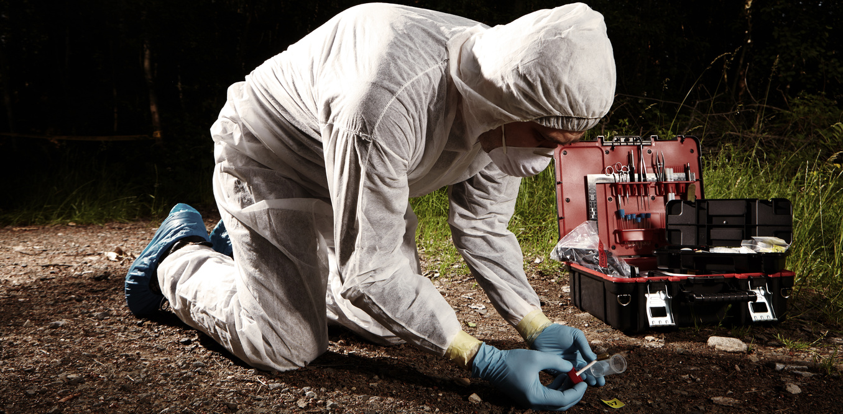
FORENSIC SCIENCE

Slide 2
FORENSIC SCIENCE
Analysis at the crime scenes could be of anything from blood stains, soil, bones, fingerprints, recovering data from mobiles, laptops, computers, DNA profiling, etc

Slide 3
Forensic Scientist
Private Investigator
Drug Analyst
Crime Laboratory Analyst
Forensic Engineer
Forensic Toxicologist
Police Officer
Forensic Consultant
Forensic Serologist
Forensic Architect
i
,

Slide 4
Commerce
Science
Humanities

Slide 5
FORENSIC SCIENCE
BSc forensic science
Diploma and Certificate
Bvoc forensic science

Slide 6
BSc Forensic Science
Qualification : Plus two science
Duration : 3 Year
Forensic Pathology
Psychiatry
Psychology
Forensic Medicine
Analysis at the crime scenes could be of anything from blood stains, soil, bones, fingerprints, recovering data from mobiles, laptops, computers, DNA profiling, etc

Slide 7
B Voc Forensic Science B Voc Applied Microbiology and Forensic science
Qualification : Plus two science with 55 marks
Duration : 3 year

Slide 8
D.B.College,Kanjirappally
Farook College,Kozhikode
KrishnaMenon Memorial Women’s College,
KannurIndiraGandhi College of Arts & Science,Kothamangalam
Devaswom Board College,KeralaCollege-
Operative Arts and Science College,MadayiCochin College, Koovappadam, Cochin-Ernakulam, Kerala, Ernakulam
Bharathamatha College,Thrikkakara
Aditya Kiran College of Applied Studies,kannur
Indira Gandhi Collegeof Arts & Science,Kothamangalam
Kuriakose Gregorios College,Mannarcaud
Kristu Jyothi College of Management , Kottayam
C.M.S.College,MannanamChrist College, Irinjalakuda
.

Slide 9
Govt colleges
Rajiv Gandhi Centre for BiotechnologyThiruvananthapuram
Amrita School of MedicineAIMS Ponekkara (PO)
Kerala University of Health Sciences (KUHS)Thrissur
T.D. Medical College Vandanam Alappuzha,
Amrita Vishwa Vidyapeetham Kochi,
Government Medical CollegeThiruvananthapuram,
Government Medical College Kozhikode,
Al-AmeenCollege , Edathala
B.K College for Women, Kottayam
Al-Azhar College of Arts & Science,Thodupuzha
Iqbal College Peringamala,Varkala
Cochin College, Koovappadam, Cochin-Ernakulam, Kerala, Ernakulam

Slide 10
Cyber Security
http://exam.cscacademy.org/admin/cyberstudents/student_dashboard

Slide 11
EMAIL AND SOCIAL MEDIA SECURITY
11.1.1General Tips on using Social Networking platforms safely
Social media have become an evident part of our life. We share out updates with our friends, family and anyone who is concerned using social media. But the hackers can use this information to steal sensitive data and hack your account. Given below are some of the general tips on using social media.
Always ask the questions:
✓ Who can access the information I am putting online?
✓ Who controls and owns the information I put into a social networking site?
✓ What information about me are my contacts passing on to other people?
✓ Will my contacts mind if I share information about them with other people?
✓ Do I trust everyone with whom I'm connected?
➢

Slide 12
Always make sure you use secure passwords to access social networks. If anyone else does get into your account, they are gaining access to a lot of information about you and about anyone else you are connected to via that social network. Change your passwords regularly as a matter of routine.
➢ Make sure you understand the default privacy settings offered by the social networking site, and how to change them.
➢ Consider using separate accounts/identities, or maybe different pseudonyms, for different campaigns and activities. Remember that the key to using a network safely is being able to trust its members. Separate accounts may be a good way to ensure that such trust is possible.
➢ Be careful when accessing your social network account in public internet spaces. Delete your password and browsing history when using a browser on a public machine.
➢ Access social networking sites using https:// to safeguard your username, password and other information you post. Using https:// rather than http:// adds another layer of security by encrypting the traffic from your browser to your social networking site.
➢ Be careful about putting too much information into your status updates – even if you trust the people in your networks. It is easy for someone to copy your information.

Slide 13
SMARTPHONE SECURITY

